Slide 1
Angular Training
Intermediate Level
Abhijit Simha R

Slide 2
Setup:
Node Version:
node --version
OPTUM’s npm registry: npm config set registry https://repo1.uhc.com/artifactory/api/npm/npm-virtual/ --global
Angular setup:
npm install -g @angular/cli

Slide 3
Create a workspace and initial application
Cmd: ng new my-app
No for strict type checking.
Select Yes(Y) for Routing.
Select SCSS for Styling.
Download VS code Editor. Link: https://code.visualstudio.com/download

Slide 4
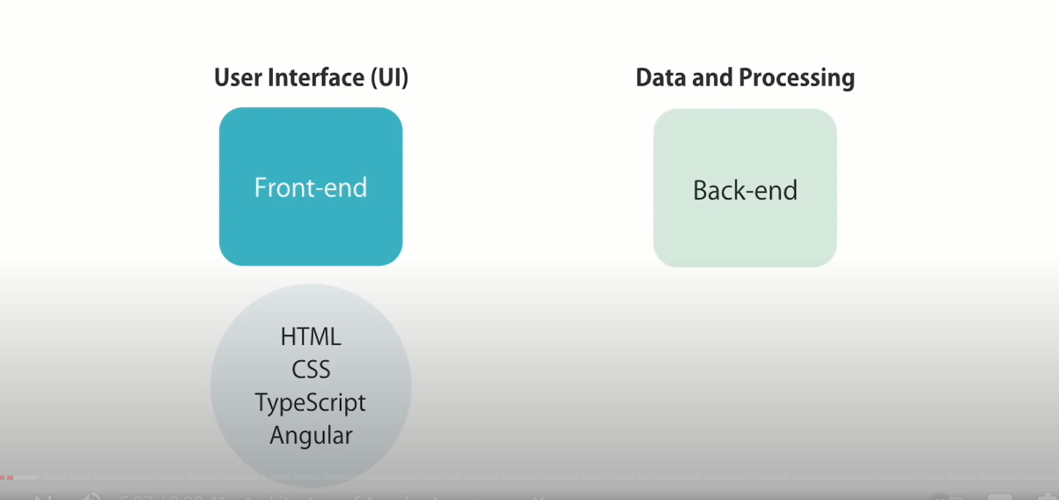
Angular Basics

Slide 5

Angular Basics
Applications that are contained within one web page are called single-page applications (SPA).
All the views are displayed in one page i.e., “index.html”.

Slide 6
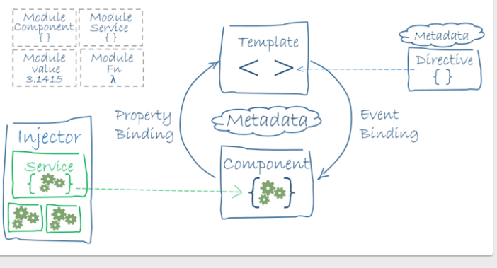
Angular Architecture
Module
Root Module

Slide 7
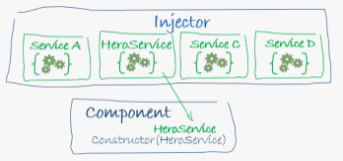
Dependency Injection

Slide 8
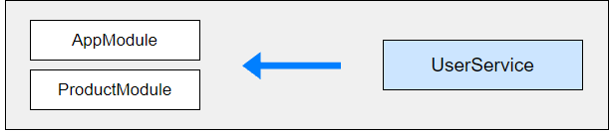

Provider Scope
Root Module Level (Application Level).
Module Level.
Component Level.
Root Module (Application Level) & Lazy Loaded Module Level (Lazy Loaded Module’s unique instance).

Slide 9
Angular Modularity
Modules are a great way to organize an application and extend it with capabilities from external libraries.
The Angular framework itself is a set of JavaScript modules.
Frequently used Angular modules :
BrowserModule
CommonModule
FormsModule
ReactiveFormsModule
RouterModule
HttpClientModule

Slide 10
Types of Modules
Root Module
Core Module
Feature Modules
Routing Modules
Shared Modules
Service Module

Slide 11
Routing
Routing allows us to navigate through all the views by configuring the route for each component that will display a view.
Navigating through Angular Application Routes
Menu option, link, image, buttons chained with click events activates a route.
Typing the URL in URL address bar.
Browser’s forward, backward buttons.
Route Configuration Eg: <base href=“/”> // index.html RouterModule.forRoot([ { path: ‘home', component: BbbCompComponent } ]), //AppModule.ts

Slide 12
Route declarations
const routes: Routes = [ // maps specific URL path segement { path: 'home', component: PcompComponent },
// specifies a router param and maps the specific URL path segment { path: 'product/:id', component: ProductDetailComponent },
// specifies & maps a empty route { path: '', redirect: 'home‘, pathMatch: ‘full'},
// specifies & maps a wildcard path route { path: '**', component: PageNotFoundComponent}];

Slide 13
Location Strategies in Angular Router
HashLocationStrategy Eg: http://localhost:4200/#/product
uses the anchor tags technique to achieve client-side routing.
PathLocationStrategy Eg: http://localhost:4200/product
HTML5 allows browsers to programmatically alter the browser’s history through the history object.
Default strategy in Angular application

Slide 14
Forms
Forms are used to collect the data from the user.
Angular supports two design approaches for interactive forms.
Template Driven Forms
HTML & Data Binding – Form template in HTML which is bind in component code.
Reactive Forms
Model Driven – Form Model & validation in component code.

Slide 15
Building Blocks of Angular Forms
FormControl tracks the value and validation status of an individual form control.
Eg: ngModel , formControl
FormGroup tracks the same values and status for a collection of form controls.
Eg: ngForm, formGroup
FormArray tracks the same values and status for an array of form controls. Eg: ngModelForm, formArray

Slide 16
HTTP Requests using HTTPClient
Most front-end applications need to communicate with a server over the HTTP protocol, to download or upload data and access other back-end services.
Module allows us to query the Remote API source to get data into our Application.
HttpClient is a separate model in Angular and is available under the @angular/common/http package.

Slide 17
Route Guards
CanActivate
CanDeactivate
Resolve
CanLoad
CanActivateChild

Slide 18
Thank You

